Slide 1

Monte Carlo Method
Jose Soto & Nathan Van De Vyvere

Slide 2
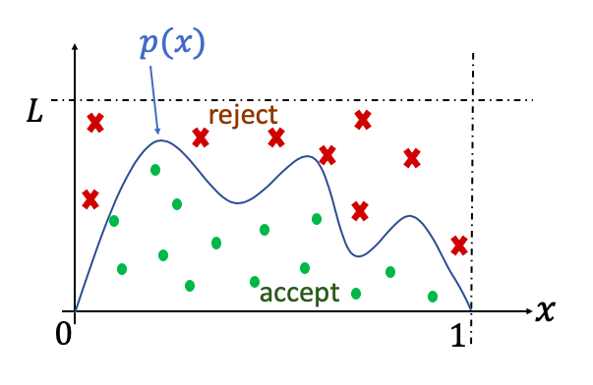
What is the Monte Carlo Method?
Monte Carlo is a algorithm for finding integrals
Places random plot points on the graph within a bounding box and counts what's below and above the graph
The amount of sample plots under the graph is divided by the total number of samples multiplied by the area of the bounding box
This number is averaged out to give you the approximate area under the curve.

Slide 3

Concept

Slide 4
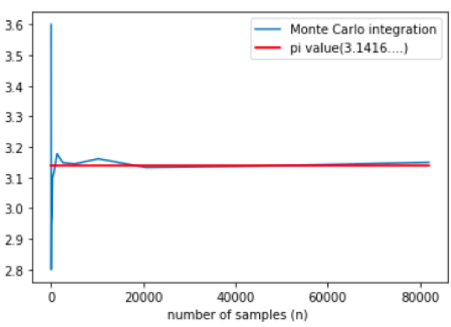
Law of Large Numbers
The more samples used to determine probability, the more accurate the results.
Example: Rolling dice or flipping a coin

Slide 5

Why is it important?
The concept allows you to calculate predictions based on certain conditions
Example: Airplane engines

Slide 6

Sequential Approach
Written in c++
Use random library to generate random coefficients for a struct
Two for loops of the loop for the problem size, first loop computes bounding box, second computes random samples
The ratio of under/total hits are calculated and multiplied by a the bounding box area and summed together
This summation is divided by the problem size to get the average answer

Slide 7

GPU Approach for our problem
Each thread calculates a bounding box and samples in that box.
Enough blocks are allocated so that each polynomial expression can be executed in parallel
Host calculates the average of all simulations to get an accurate result

Slide 8
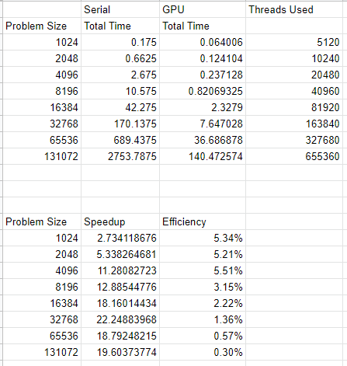
Tables

Slide 9
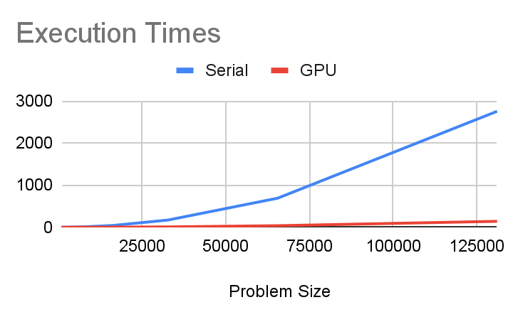

Slide 10
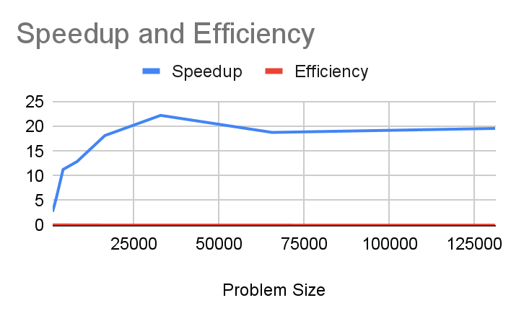

Slide 11
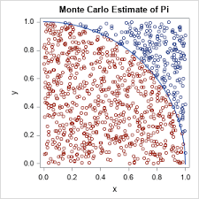
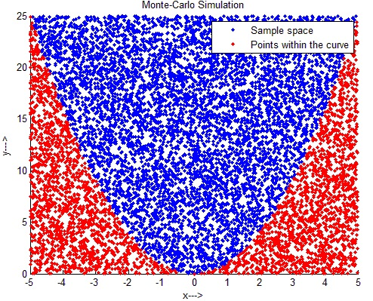
Conclusion
Our method was accurate (<.01% error)
Good speedup but very inefficient
With more time we could work on increasing efficiency and generating other types of expressions other than just polynomials

Slide 12
Sources
https://www.scratchapixel.com/lessons/mathematics-physics-for-computer-graphics/monte-carlo-methods-in-practice/monte-carlo-integration
https://en.wikipedia.org/wiki/Monte_Carlo_integration
Data Science Essentials in Python by Dmitry Zinoviev
https://www.youtube.com/watch?v=7ESK5SaP-bc&ab_channel=MarbleScience

